Slide 1
Deploying Java Apps with Kubernetes
Fernando Segura
Director of Infrastructure @ Osigu
@fernandosure

Slide 2
Agenda
What is a container?
Why do we need containers?
What is Docker?
Embrace immutable infrastructure
Build, ship and deploy containers with java
Container Orchestration
Kubernetes

Slide 3
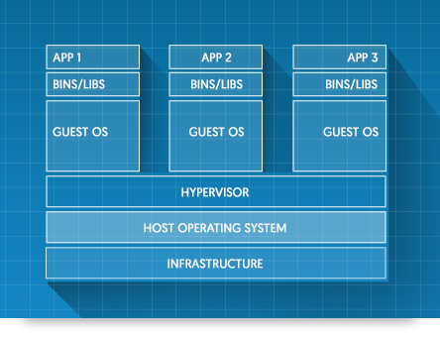
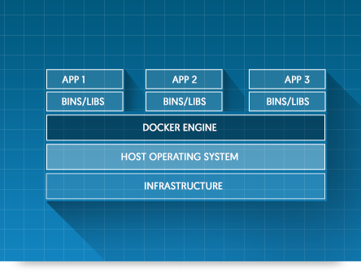
What is a container?
Notes:
VIRTUAL MACHINES
Virtual machines include the application, the necessary binaries and libraries, and an entire guest operating system -- all of which can amount to tens of GBs
CONTAINERS
Containers include the application and all of its dependencies --but share the kernel with other containers, running as isolated processes in user space on the host operating system. Docker containers are not tied to any specific infrastructure: they run on any computer, on any infrastructure, and in any cloud

Slide 4
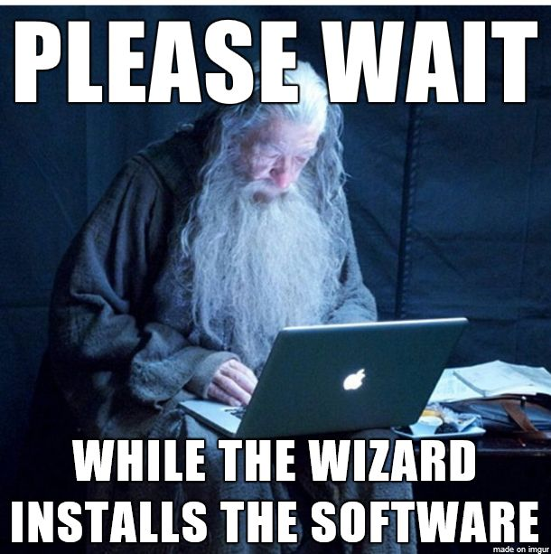
Why do we need containers?
Why don’t just copy my jar|war|ear file to my server?
Notes:
The whole process of provisioning and configuring a server in the old way takes too long and is very common to ssh into the server and install things manually
install OS
install jvm
install libraries and dependencies
install application servers
finally you need to make it secure
and then expose it to the public

Slide 5
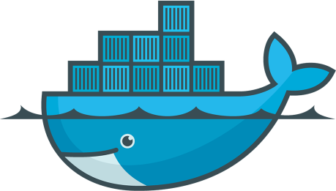

What is Docker?
Isolation
Lightweight
Portability
Fast application startup (from minutes to seconds)
Note: Installing docker
sudo curl -fsSL https://get.docker.com/ | sh
Notes:
Is an open standard for using containers enabling them to run on all major Linux distributions and on Microsoft Windows -- and on top of any infrastructure.
The isolation and security allow you to run many containers simultaneously on a given host. Containers are lightweight because they don’t need the extra load of a hypervisor, but run directly within the host machine’s kernel. This means you can run more containers on a given hardware combination than if you were using virtual machines. You can even run Docker containers within host machines that are actually virtual machines!

Slide 6
Docker terminology
Docker engine
Builds, ships and runs the containers, either on the host locally or in the cloud
Docker image
Read-only template for creating containers (snapshot)
Docker container
Runtime representation of the image
Docker registry (https://hub.docker.com)
Place for storing and sharing docker images

Slide 7
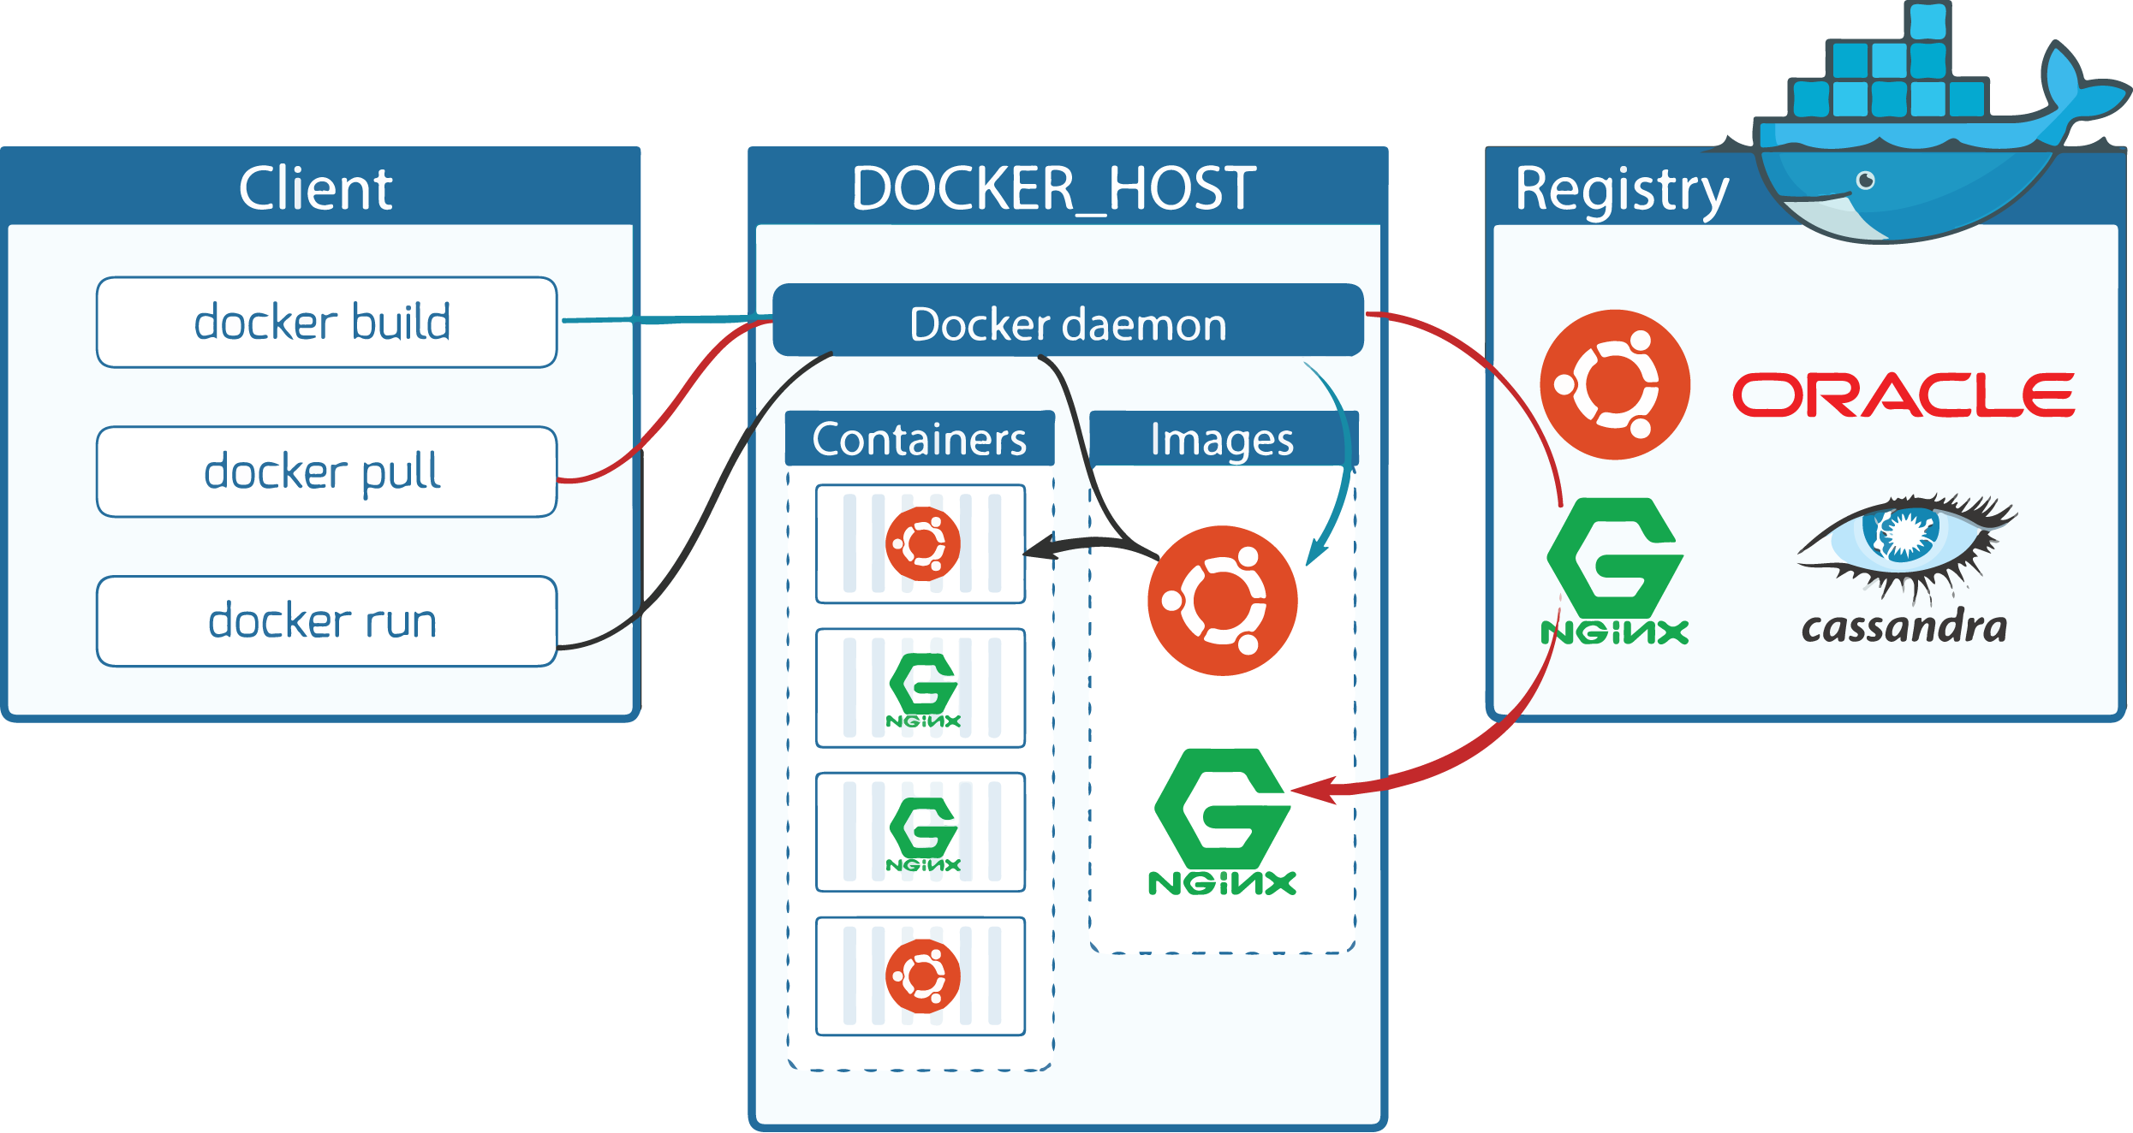
Docker flow

Slide 8
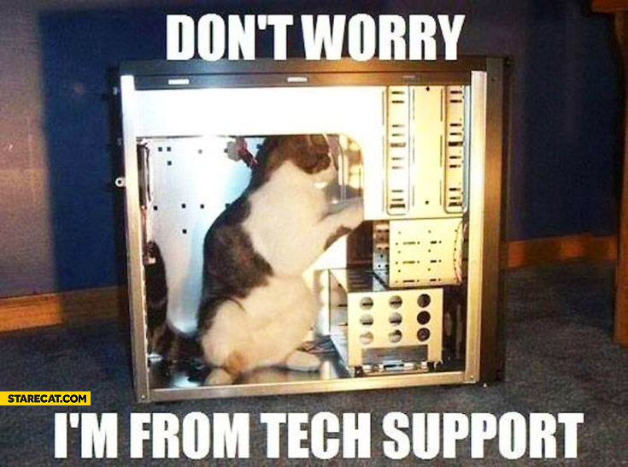
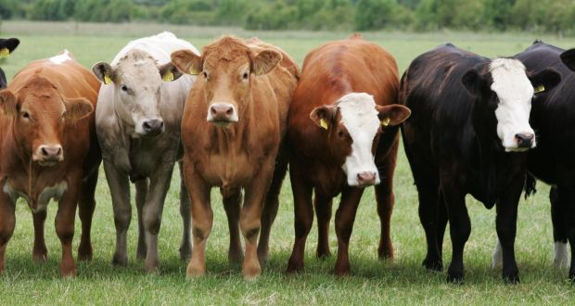


Embrace immutable infrastructure!
Treat your infrastructure like cattle not pets!
Has a name
Is unique or rare
Needs personal attention
If it get ill, you make it better
Has a number
One is much like any other
Run as a group
If it gets ill, well …
Note: No animals were harmed in the making of this slide

Slide 9
Integrating Java with Docker
Dockerfile
FROM java:8
ADD java-docker-integration.jar app.jar
ENTRYPOINT ["java", "-jar","/app.jar"]

Slide 10
Build, Ship, Run
On the developer environment or CI server
docker build –t java-docker-integration .
docker push fernandosure/java-docker-integration
On the QA environment or production server
docker run –p 8080:5000 java-docker-integration

Slide 11
Spring boot, Gradle & Docker
Demo time!

Slide 12
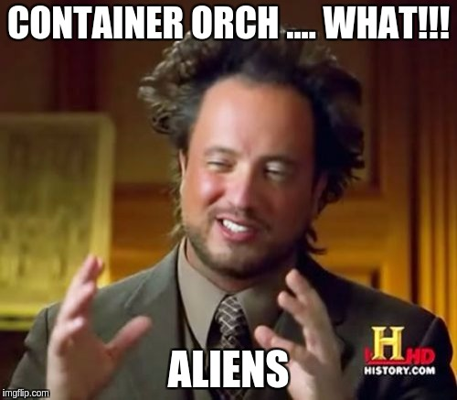
Let’s talk about container orchestration!

Slide 13
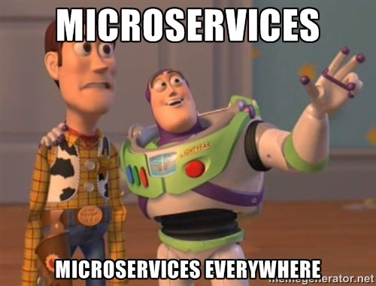
The need for container orchestration?

Slide 14
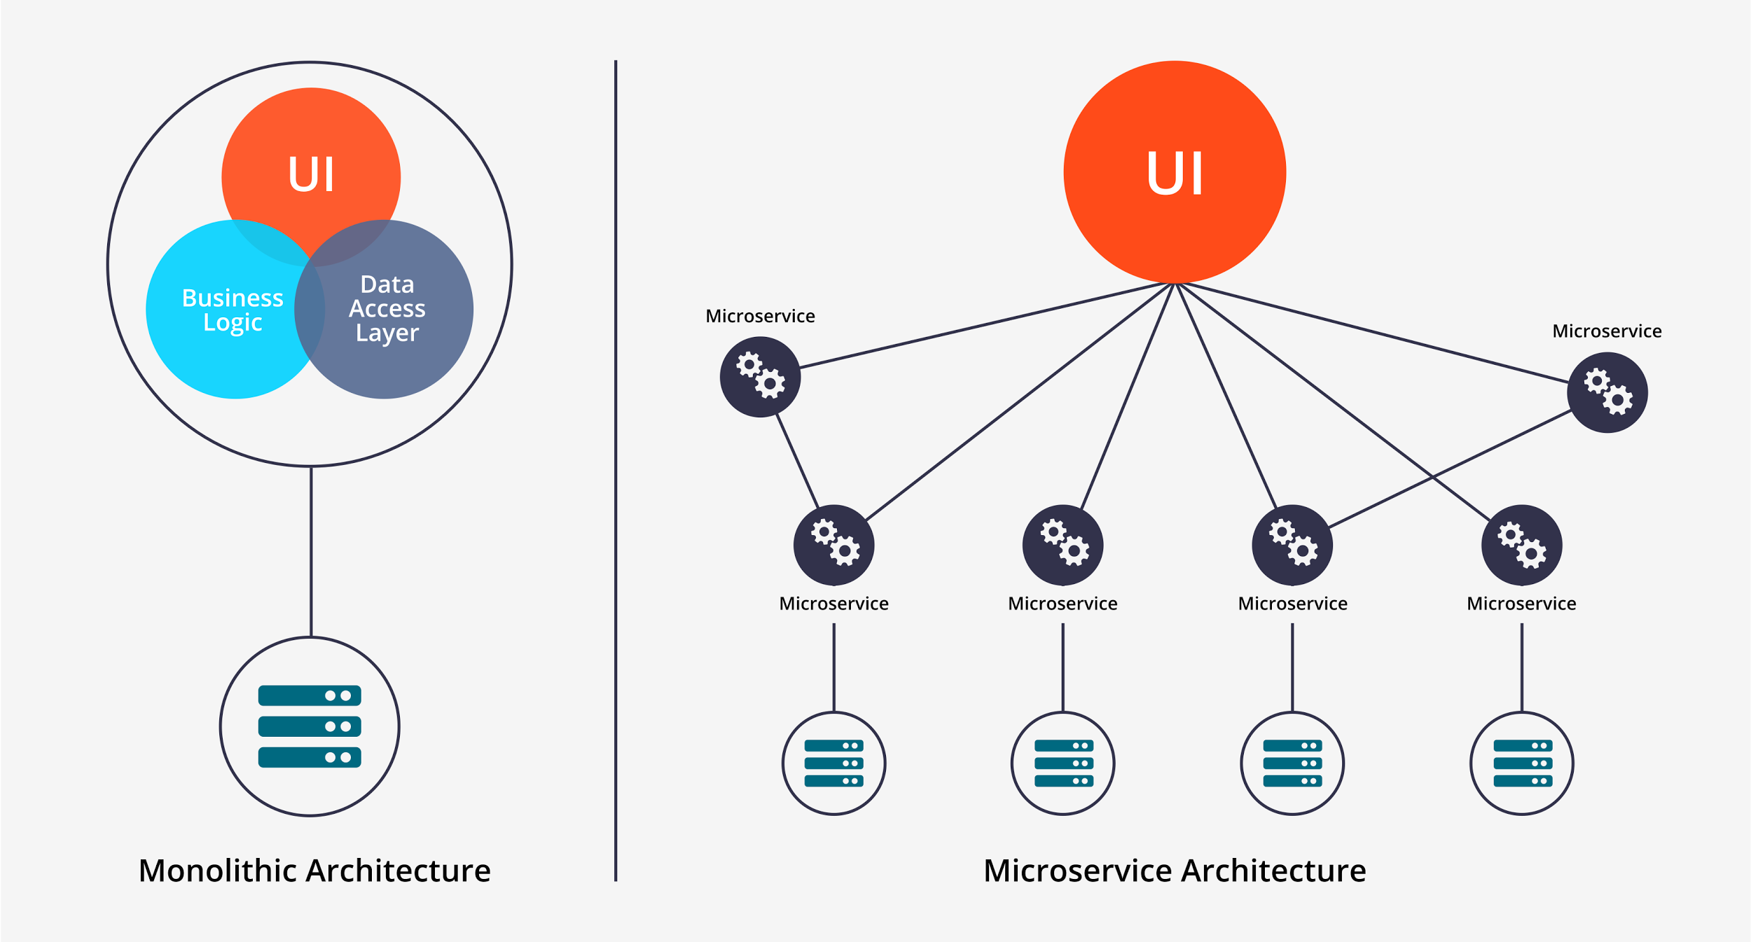
Monolith application vs microservices

Slide 15
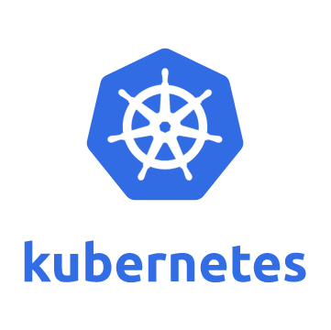
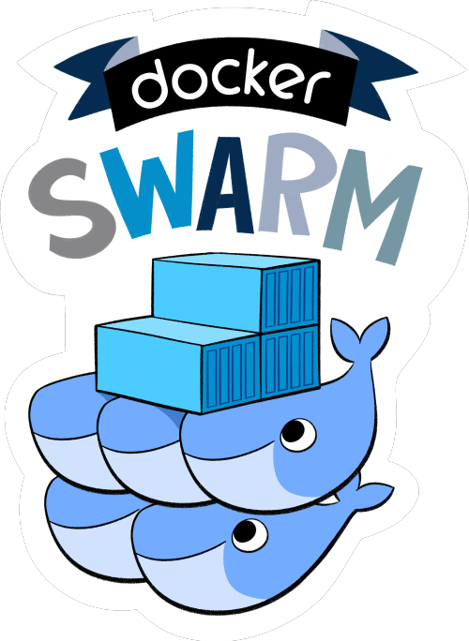
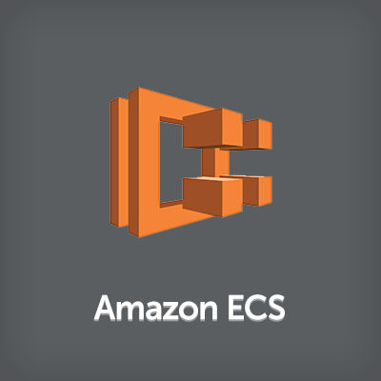
Top 3 docker container orchestration solutions

Slide 16
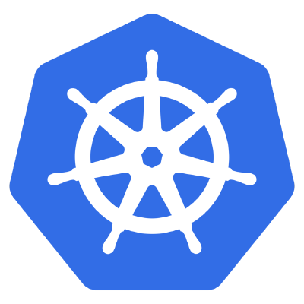
What is Kubernetes
Container orchestrator
Multiple cloud and bare metal environments
Open source
Manage applications not machines
Kubernetes builds upon 15 years of experience of running production workloads at Google
Google runs billions of containers a week

Slide 17
What Kubernetes can do for us
Scheduling (where the containers are placed)
Horizontal scaling (How many instances do I need)
Self-healing (Restart containers that fail or when nodes die)
Service discovery & load balancing (do i need to remember ip-addresses)
Rolling updates (deployments without downtime)
Secret and configuration management (no more passwords in the source code)

Slide 18
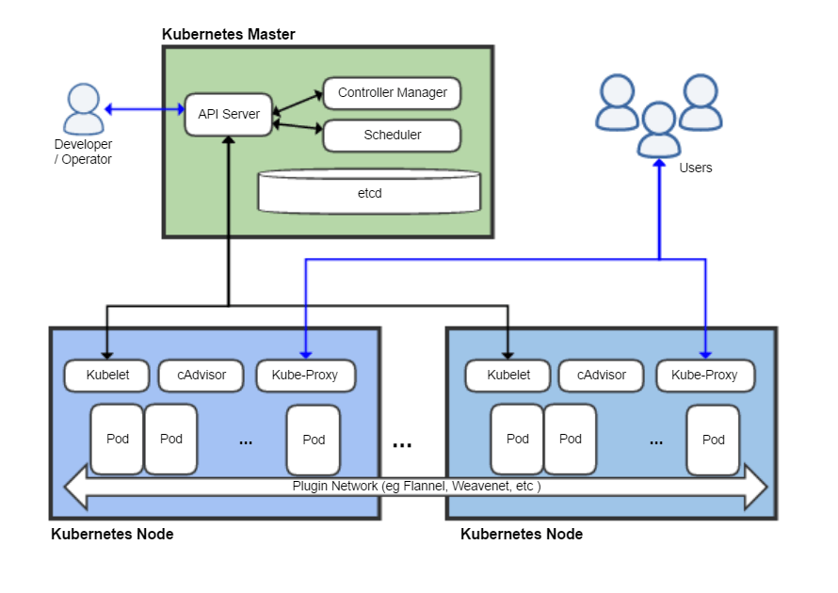
Kubernetes Architecture

Slide 19
Deploying java apps with Kubernetes
Demo time!

Slide 20
Basic Kubectl commands
1. Create a deployment
kubectl run demo-service --image=fernandosure/java-docker-integration:11 --port=5000
2. Scale deployment to 4 replicas
kubectl scale deployment/demo-service --replicas=4
3. Create a service with different ingress port than target port
kubectl expose deployment/demo-service --type="LoadBalancer" --port=80 --target-port=5000
4. Get service external IP address
kubectl get service
5. Rolling update to a new service version
kubectl set image deployment/demo-service demo-service=fernandosure/java-docker-integration:12
6. Verify rolling update status
kubectl get rs -o wide

Slide 21
Links
Slides: http://bit.ly/fernandosure-java-day-2017
Github https://github.com/fernandosure/java-docker-integration
Docker http://docker.com
Docker Hub http://hub.docker.com
Kubernetes: https://kubernetes.io
Google Container Engine: https://cloud.google.com/container-engine
Kops: https://github.com/kubernetes/kops
Install Kubernetes on AWS: https://kubernetes.io/docs/getting-started-guides/kops
Docker gradle plugin:
https://github.com/spotify/docker-maven-plugin
https://spring.io/guides/gs/spring-boot-docker/

